Slide 1
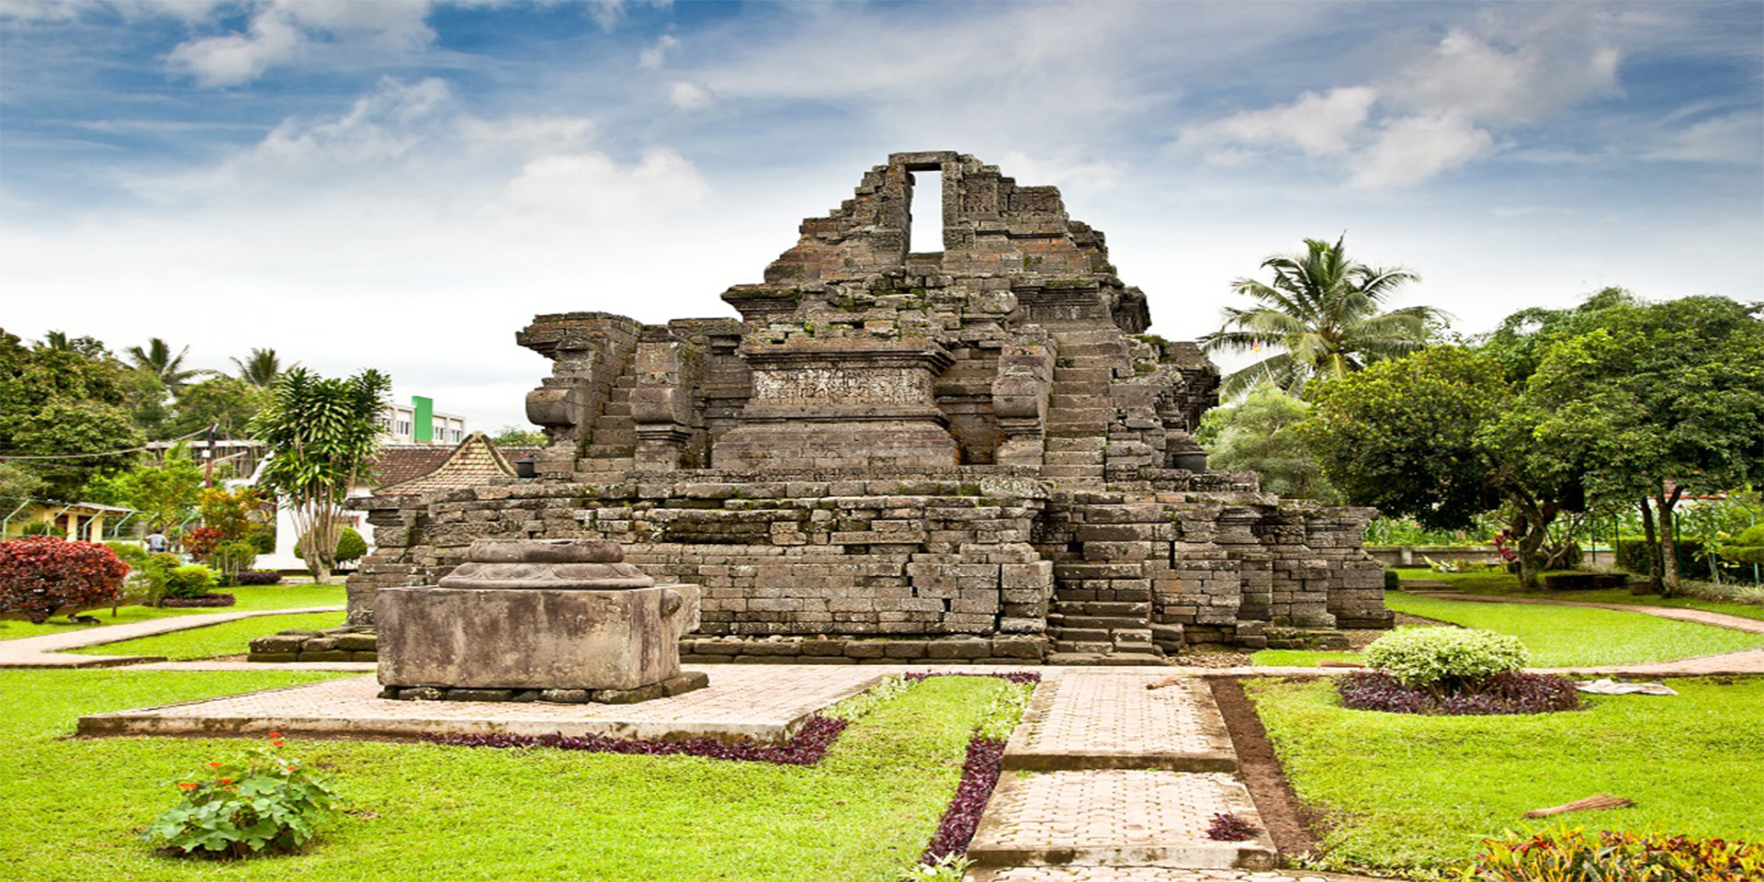
H U M A N & C O M P U N T E R I N T E R A C T I O N
WEB
CANDI DJAGO
Presented by Team One

Slide 2
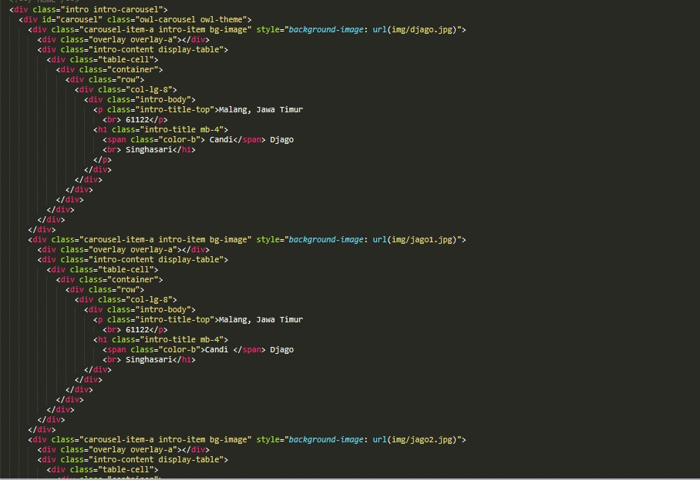
LANGUANGE
HTML
HOME

Slide 3
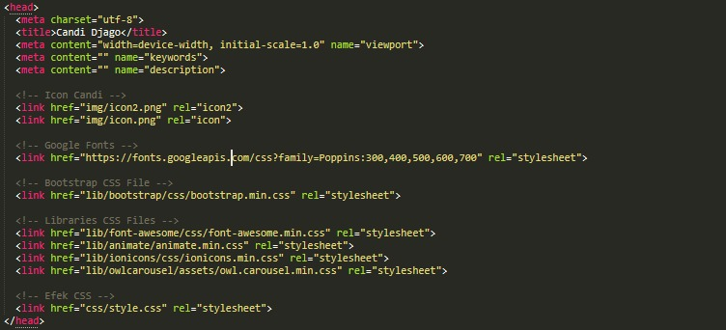
LANGUANGE
HTML
EFFECT

Slide 4
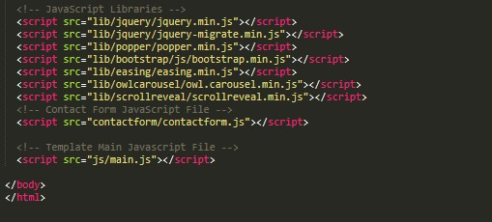
LANGUANGE
HTML
EFFECT

Slide 5
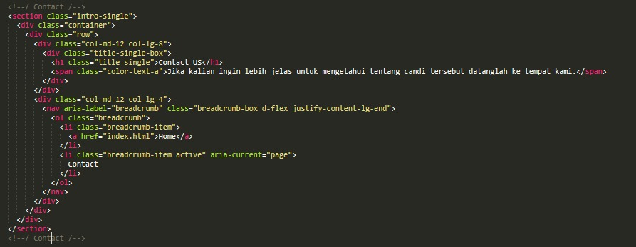
LANGUANGE
HTML
CONTACT

Slide 6
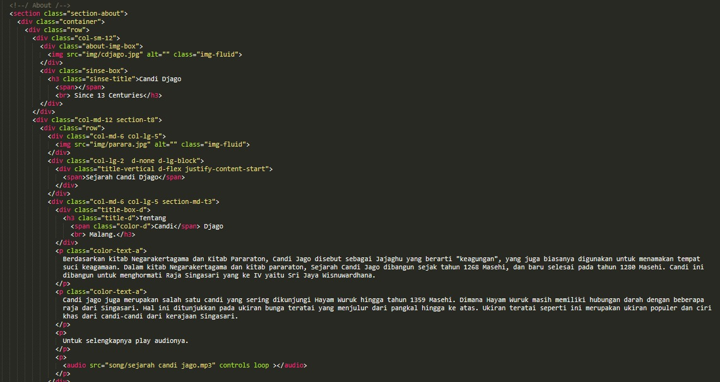
LANGUANGE
HTML
ABOUT

Slide 7
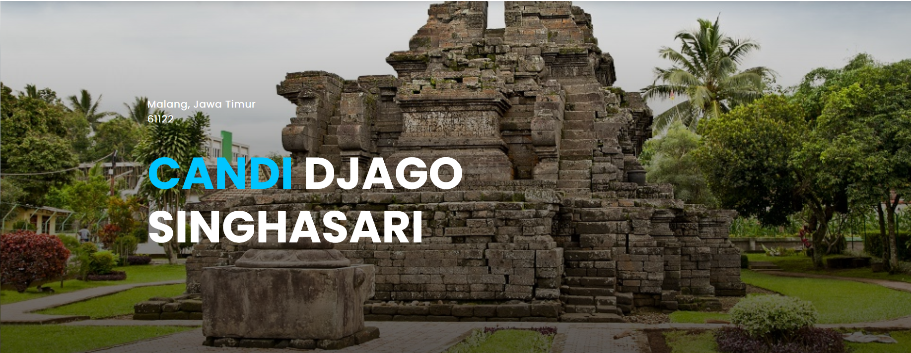
OUR WEB
HOME

Slide 8
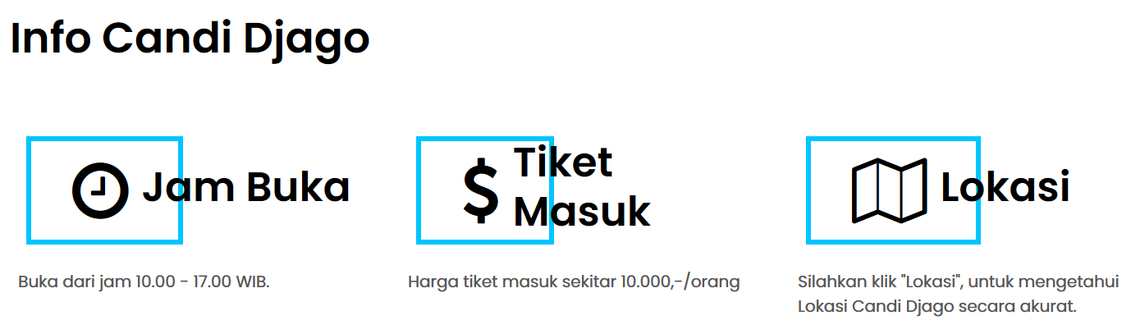
OUR WEB
HOME

Slide 9
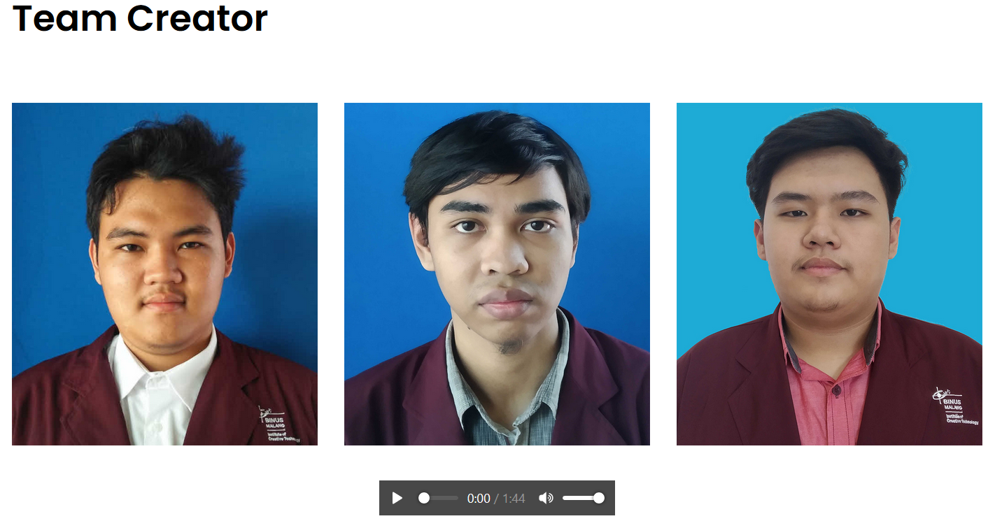
OUR WEB
HOME

Slide 10
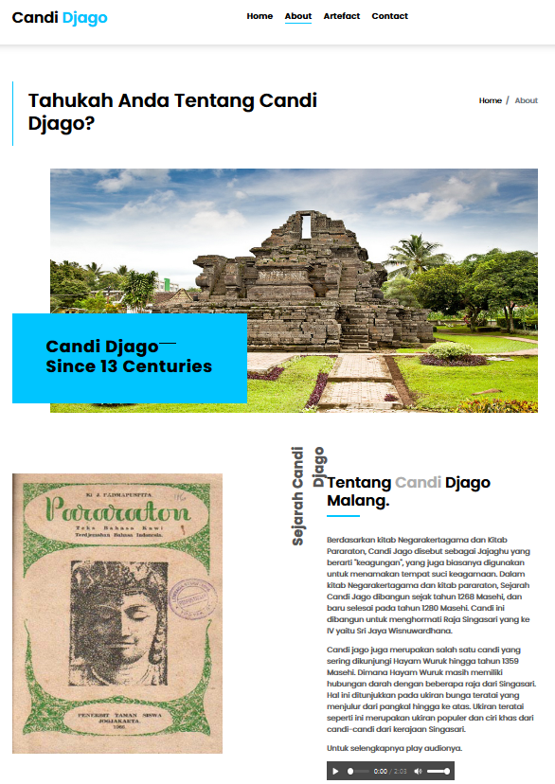
OUR WEB
ABOUT

Slide 11
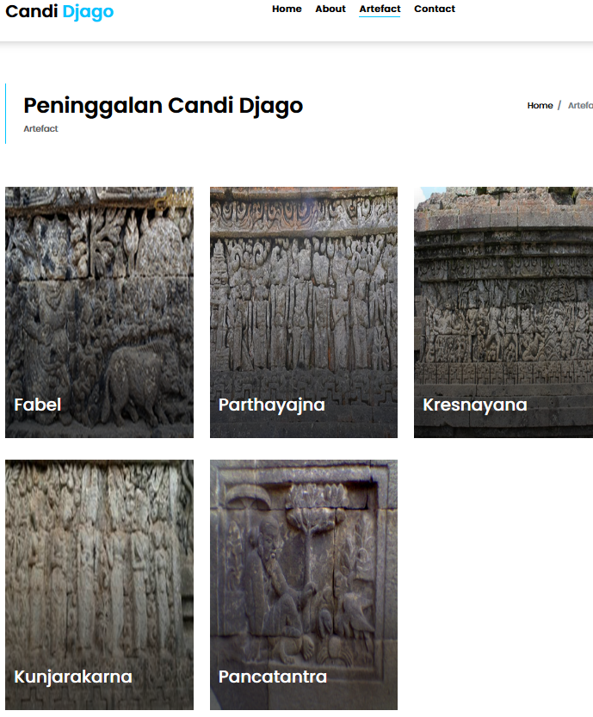
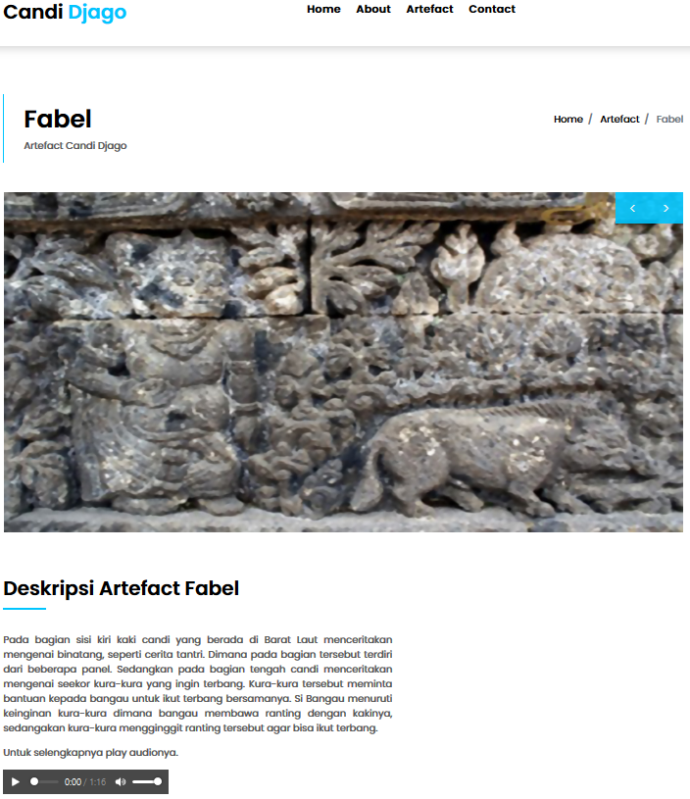
OUR WEB
ARTEFACT

Slide 12
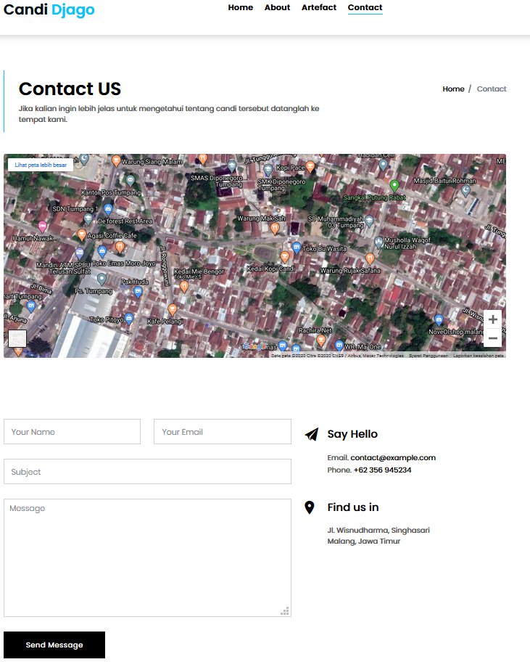
OUR WEB
CONTACT

Slide 13
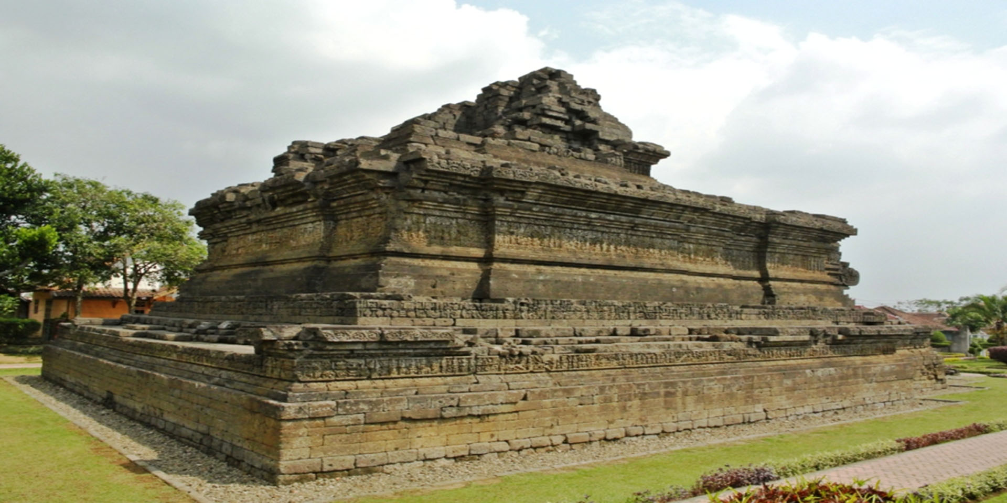
FROM US
Terimakasih buat waktu dan kesempatan yang diberikan, sekian presentasi kami, jika ada keselahan mohon dimaafkan.
THANK YOU ALL.
CANDI DJAGO

